Slide 1
Machine Cycles
A machine (bus) cycle consists of at least four clock cycles, called T states.
A specific, defined action occurs during each T state (labeled T1 – T4)
T1: Address is output
T2: Bus cycle type (Mem/IO, read/write)
T3: Data is supplied
T4: Data latched by CPU, control signals removed

Slide 2
T States
Why are there T states?
In the 8086/8088, the address and data lines are multiplexed.
The microprocessor needs time to change the signals during each bus cycle.
Memory devices need time to decipher the address value and then read/write the data (access time)

Slide 3
Timing
The period of one bus cycle is at least four times a clock cycle
10-MHz 8086 CPU
Each clock cycle has a period of 100ns
Machine cycle period is 400ns

Slide 4
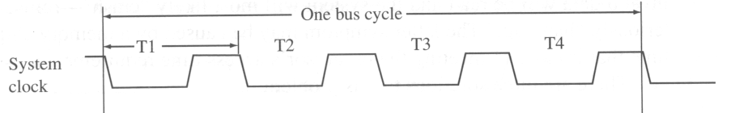
Timing
400 ns
100 ns

Slide 5
Timing
Although the system clock has a constant period, the bus cycle does not
Slow devices (memory or I/O) must request extra time.
The microprocessor inserts extra wait states between states T3 and T4
The alternatives are to slow down the system clock, or use faster devices

Slide 6
Timing
Wait state inserted here

Slide 7




Minimum and Maximum Modes For 8086 Microprocessor

Slide 8




ROAD MAP
General Bus Operation
Minimum Mode configuration In 8086
Maximum Mode Configuration In 8086
2

Slide 9

General Bus Operation
The 8086 has a combined address and data bus commonly referred as a time multiplexed address and data bus.
The main reason behind multiplexing address and data over the same pins is the maximum utilization of processor pins and it facilitates the use of 40 pin standard DIP package.
The bus can be demultiplexed using a few latches and transreceivers, when ever required.
Basically, all the processor bus cycles consist of at least four clock cycles. These are referred to as T1, T2, T3, T4. The address is transmitted by the processor during T1. It is present on the bus only for one cycle.

Slide 10

The negative edge of this ALE pulse is used to separate the address and the data or status information. In maximum mode, the status lines S0, S1 and S2 are used to indicate the type of operation.
Status bits S3 to S7 are multiplexed with higher order address bits and the BHE signal.
Address is valid during T1 while status bits S3 to S7 are valid during T2 through T4.

Slide 11

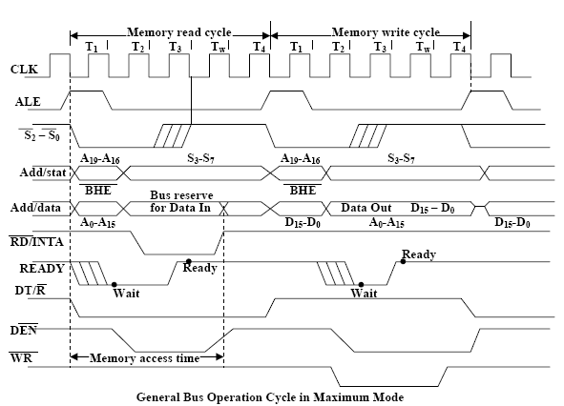
General Bus Cycle For 8086

Slide 12

Minimum Mode 8086 System
The microprocessor 8086 is operated in minimum mode by strapping its MN/MX pin to logic 1.
In this mode, all the control signals are given out by the microprocessor chip itself. There is a single microprocessor in the minimum mode system.
The remaining components in the system are latches, transreceivers, clock generator, memory and I/O devices.
Latches are generally buffered output D-type flip-flops like 74LS373 or 8282. They are used for separating the valid address from the multiplexed address/data signals and are controlled by the ALE signal generated by 8086.

Slide 13

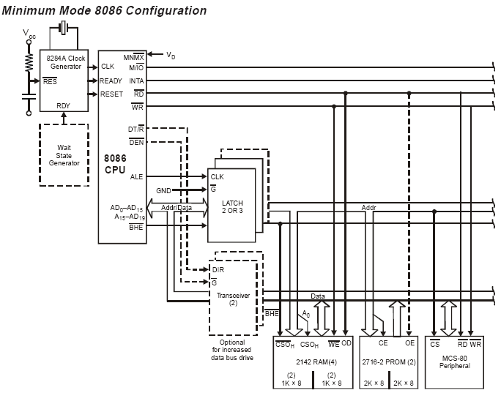
Minimum Mode Configuration For 8086

Slide 14

Transreceivers are the bidirectional buffers and some times they are called as data amplifiers. They are required to separate the valid data from the time multiplexed address/data signals. They are controlled by two signals namely, DEN and DT/R.
The DEN signal indicates the direction of data, i.e. from or to the processor.
The system contains memory for the monitor and users program storage. Usually, EPROM are used for monitor storage, while RAM for users program storage. A system may contain I/O devices.
The opcode fetch and read cycles are similar. Hence the timing diagram can be categorized in two parts, the first is the timing diagram for read cycle and the second is the timing diagram for write cycle.
The read cycle begins in T1 with the assertion of address latch enable (ALE) signal and also M / IO signal. During the negative going edge of this signal, the valid address is latched on the local bus.

Slide 15

The BHE and A0 signals address low, high or both bytes. From T1 to T4 , the M/IO signal indicates a memory or I/O operation.
At T2, the address is removed from the local bus and is sent to the output. The bus is then tristated. The read (RD) control signal is also activated in T2.
The read (RD) signal causes the address device to enable its data bus drivers. After RD goes low, the valid data is available on the data bus.
The addressed device will drive the READY line high. When the processor returns the read signal to high level, the addressed device will again tristate its bus drivers.

Slide 16

A write cycle also begins with the assertion of ALE and the emission of the address.
The M/IO signal is again asserted to indicate a memory or I/O operation. In T2, after sending the address in T1, the processor sends the data to be written to the addressed location.
The data remains on the bus until middle of T4 state. The WR becomes active at the beginning of T2 (unlike RD is somewhat delayed in T2 to provide time for floating).
The BHE and A0 signals are used to select the proper byte or bytes of memory or I/O word to be read or write.
The M/IO, RD and WR signals indicate the type of data transfer as specified in table below.

Slide 17
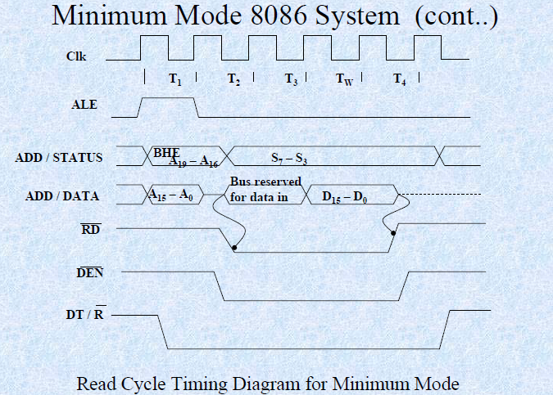

Slide 18

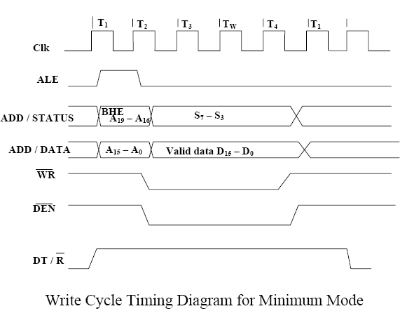

Slide 19

Hold Response sequence:
The HOLD pin is checked at leading edge of each clock pulse. If it is received active by the processor before T4 of the previous
cycle or during T1 state of the current cycle, the CPU activates HLDA in the next clock cycle and for succeeding bus cycles, the bus will be given to another requesting master.
The control of the bus is not regained by the processor until the requesting master does not drop the HOLD pin low.
When the request is dropped by the requesting master, the HLDA is dropped by the processor at the trailing edge of the next clock.

Slide 20

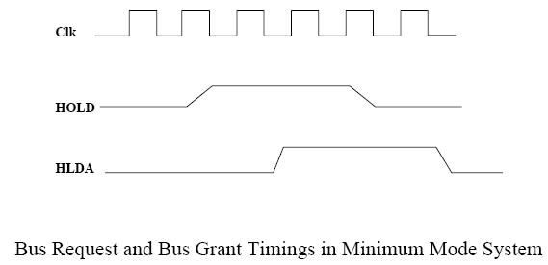
Hold Response Timing Cycle

Slide 21

Maximum Mode 8086 System
In the maximum mode, the 8086 is operated by strapping the MN/MX pin to ground.
In this mode, the processor derives the status signal S2, S1, S0.
Another chip called bus controller derives the control signal using this status information .
In the maximum mode, there may be more than one microprocessor in the system configuration. The components in the system are same as in the minimum mode system.
The basic function of the bus controller chip IC8288, is to derive control signals like RD and WR ( for memory and I/O devices), DEN, DT/R, ALE etc. using the information by the processor on the status lines.

Slide 22

The bus controller chip has input lines S2, S1, S0 and CLK. These inputs to 8288 are driven by CPU.
It derives the outputs ALE, DEN, DT/R, MRDC, MWTC, AMWC, IORC, IOWC and AIOWC. The AEN, IOB and CEN
pins are specially useful for multiprocessor systems.
AEN and IOB are generally grounded. CEN pin is usually tied to
+5V. The significance of the MCE/PDEN output depends upon the status of the IOB pin.
INTA pin used to issue two interrupt acknowledge pulses to the interrupt controller or to an interrupting device.

Slide 23

IORC, IOWC are I/O read command and I/O write command signals respectively . These signals enable an IO interface to read or write the data from or to the address port.
The MRDC, MWTC are memory read command and memory write command signals respectively and may be used as memory read or write signals.
All these command signals instructs the memory to accept or send data from or to the bus.
Here the only difference between in timing diagram between minimum mode and maximum mode is the status signals used and the available control and advanced command signals.

Slide 24

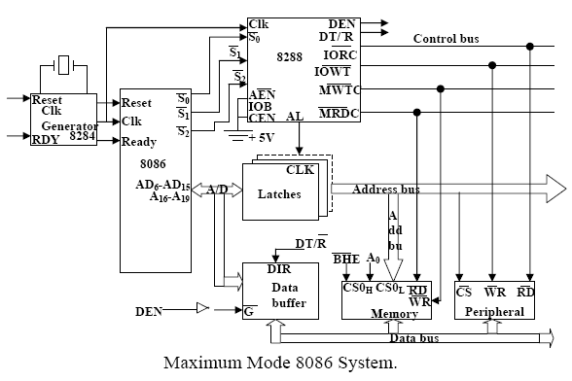
Maximum Mode Configuration For 8086

Slide 25

R0, S1, S2 are set at the beginning of bus cycle.8288 bus controller will output a pulse as on the ALE and apply a required signal to its DT / R pin during T1.
In T2, 8288 will set DEN=1 thus enabling transceivers, and for an input it will activate MRDC or IORC. These signals are activated until T4.
For an output, the AMWC or AIOWC is activated from T2 to T4 and MWTC or IOWC is activated from T3 to T4.
The status bit S0 to S2 remains active until T3 and become passive during T3 and T4.
If reader input is not activated before T3, wait state will be inserted between T3 and T4.

Slide 26

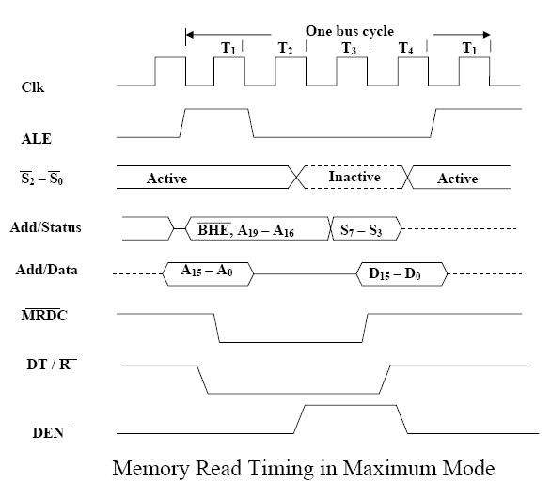

Slide 27

